Slide 1
Tutorial 2. Encryption – Why and How
Week 2: 2026-03-12, 14:00-15:00, Thursday

Slide 2
Payroll System Design Challenge
Scenario:
  As an engineer of TechCom, you are tasked to design a secure payroll database. The company has 1,000 employees with salaries ranging from $30K to $200K. Competitors are trying to poach your top talent, and salary confidentiality is crucial for retention.
Objectives: your solution should
  Prevent identical salaries from being identified
  Defend against statistical attacks

Slide 3
Some Options
Option A: Simple Encryption
  Use AES encryption for the entire database
  Encrypt each salary field separately
  Use a fixed key
Option B: Obfuscation + Encryption
  Encrypt (salary value + random salt)
  Example: 50000 + 12345 = 62345, then encrypt

Slide 4
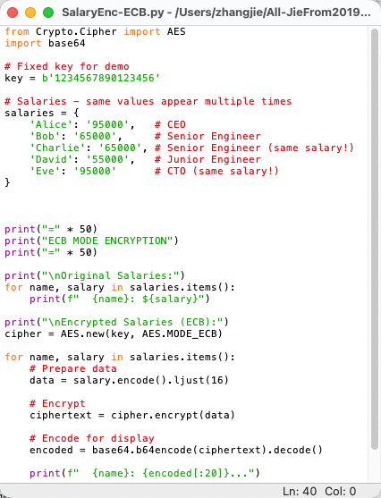
ECB Encryption's Fatal Flaw
AES ECB Mode Encryption of Salaries
==================================================
ECB MODE ENCRYPTION
==================================================
Original Salaries:
Alice: $95000
Bob: $65000
Charlie: $65000
David: $55000
Eve: $95000
Encrypted Salaries (ECB):
Alice: F4pQJq9tUXHZpCDJZGC3...
Bob: u+EyzztEsNujRQAQoiY4...
Charlie: u+EyzztEsNujRQAQoiY4...
David: 3ioD81rpePjGXQ6fCI3R...
Eve: F4pQJq9tUXHZpCDJZGC3...
==================================================

Slide 5
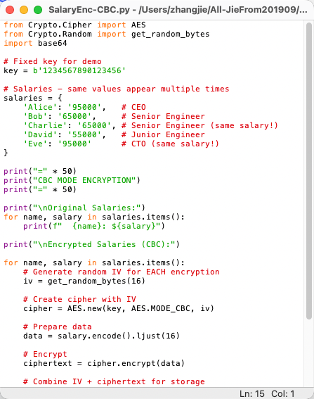
How CBC Fixes the Problem
AES CBC Mode Encryption of Salaries
==================================================
CBC MODE ENCRYPTION
==================================================
Original Salaries:
Alice: $95000
Bob: $65000
Charlie: $65000
David: $55000
Eve: $95000
Encrypted Salaries (CBC):
Alice: /hOaMIgU4Ua6lOCPohxn...
Bob: UFR3KEvqOJyi1fT24Qt9...
Charlie: Slgf8cLeq+0Tn9vZSWZZ...
David: +xCxTN/ph5QRaJ5/yO27...
Eve: EznSLRb2lHqyDKCafn52...
==================================================

Slide 6
Comparison
ECB vs CBC Mode Encryption of Salaries
Security Issue | ECB's Problem | CBC's Solution
Identical Data Recognition | Same salary → Same ciphertext | Same salary → Different ciphertext
Frequency Analysis | Can identify common salaries | No statistical analysis possible
Pattern Matching | Can see organizational hierarchy patterns | All records appear random
Data Correlation | Can correlate employees with same salaries | Each record appears independent

Slide 7
Beyond Payroll Systems
Application 1: Medical Records
diseases = ["CANCER", "DIABETES", "CANCER", "FLU", "DIABETES"]
Using ECB: Can count how many cancer patients
Using CBC: Each disease record is unique

Slide 8
Beyond Payroll Systems
Application 2: Voting Systems
Anonymous Voting Requirements:
  Cannot tell who voted what
ECB Problem: All "YES" votes look identical
CBC Solution: Every "YES" vote looks different

Slide 9
Beyond Payroll Systems
Application 3: Location Tracking
Employee Location History:
  At office: Encrypted location
  At home: Encrypted location
Using ECB: Can see when employee is at same location
Using CBC: Each location record is different

Slide 10
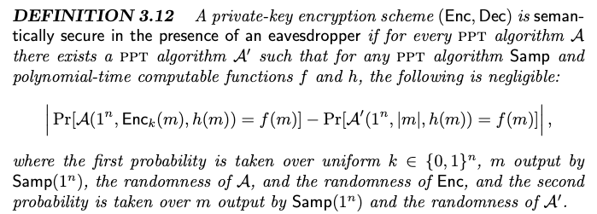
Semantic Security
CBC provides semantic security:
Ciphertexts reveal no information about plaintexts except their length.
Formal definition

